Slide 1
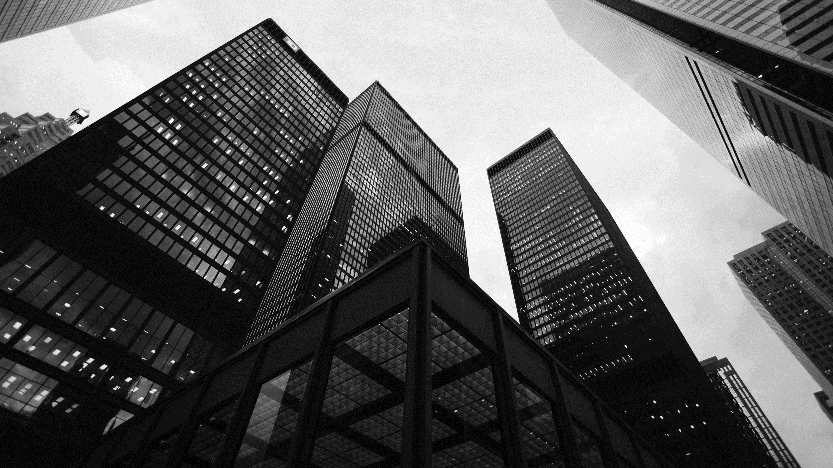
RedXParking
DEMO & PRESENTATION 2
Notes:
Photo by Sean Pollock on Unsplash

Slide 2
SPRINT 2
Notes:
Photo by Sean Pollock on Unsplash

Slide 3
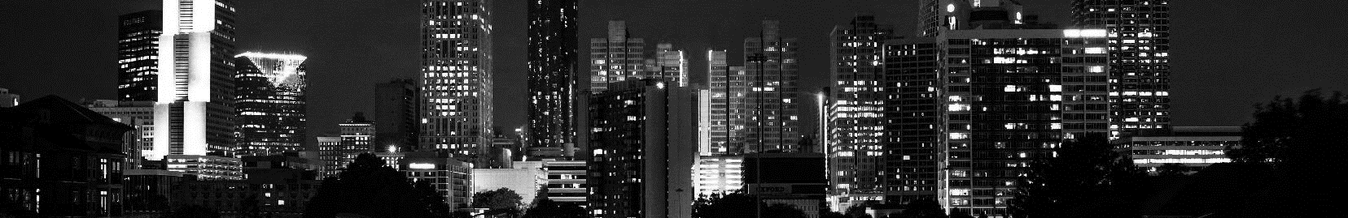
SPRINT 2 - GOALS
Adding pi camera for more accurate detection.
Integrating Melbourne Open parking data and the sensor data for better user experience.
Implementing of a php web application.
Notes:
<a href="https://www.freepik.com/free-photos-vectors/business">Business photo created by rawpixel.com - www.freepik.com</a>

Slide 4
Sense, Think & Act
Notes:
Photo by Sean Pollock on Unsplash

Slide 5
Sense, Think & Act
Sense – Detecting whether there is a vehicle in a parking spot
Data driven solution to address the issue using the publicly available dataset.
For the parking spots that doesn’t have sensors we implement our own sensors.
Think – Whether displaying available or occupied for the bay.
Act – displaying the status of the parking bay
Notes:
<a href="https://www.freepik.com/free-photos-vectors/business">Business photo created by rawpixel.com - www.freepik.com</a>

Slide 6
User Stories - Features
User Story | Features | Points
As a designer I would like to have feedback and user requirements so I can design the system a user friendly manner | Feedback | 1
As a software developer I would like to know the hardware design to create the relevant software. | Hardware design for the relevant software | 3
As a user I could like to get frequent updates about the availability of the parking spots while reaching the spot. | Frequent updates | 4
As a hardware developer I would like to know the sensing requirements of the system to create a robust hardware design. | Sensing requirements | 2
Notes:
<a href="https://www.freepik.com/free-photos-vectors/business">Business photo created by rawpixel.com - www.freepik.com</a>

Slide 7
User Stories – Features
User Story | Feature | Points
As a hardware developer I would like to know the requirements of the software to make the hardware accordingly. | Software Requirements | 3
As the software developer I would like to know the requirements of the user to create the system diagram | User requirements for system diagram design. | 2
As a user I would like to know about available parking venues and availability of parking spots near the venue I want to go. | About available parking venues and availability of parking spots | 5
As the web developer I would like to know the data transferring protocols to create the web API | Data transferring protocols | 1
Notes:
<a href="https://www.freepik.com/free-photos-vectors/business">Business photo created by rawpixel.com - www.freepik.com</a>

Slide 8
User Stories – Features
User Story | Feature | Points
As the software developer I would like to know the requirements of the pi Camera to implement more accurate motion detection | Pi camera Requirements | 5
As the software developer I would like to get Melbourne Open parking data and the sensor data so that I can implement a system better user experience. | Melbourne Open parking data and the sensor data | 4
Notes:
<a href="https://www.freepik.com/free-photos-vectors/business">Business photo created by rawpixel.com - www.freepik.com</a>

Slide 9
Backlog
https://app.gitkraken.com/glo/board/XW4APgtDJAAPHCC6
Notes:
<a href="https://www.freepik.com/free-photos-vectors/business">Business photo created by rawpixel.com - www.freepik.com</a>

Slide 10
Burndown Chart
Notes:
<a href="https://www.freepik.com/free-photos-vectors/business">Business photo created by rawpixel.com - www.freepik.com</a>

Slide 11
HARDWARE
Notes:
Photo by Sean Pollock on Unsplash

Slide 12
HARDWARE
Arduino platform is used to create the basic protype needed for implementation.
AtMega328p is used as the base microcontroller for the final design.
Using ultrasonic sensor for motion detection.
Raspberry Pi is used to create nodes to json data logging to the central node (Cloud Service)
Pi camera used to replace the ultrasonic sensor for better detection.
Notes:
<a href="https://www.freepik.com/free-photos-vectors/business">Business photo created by rawpixel.com - www.freepik.com</a>

Slide 13
SOFTWARE
Notes:
Photo by Sean Pollock on Unsplash

Slide 14
SOFTWARE
Our server consist of two application layers (data service backend, responsive front end)
Backend is consisted of necessary software to log data to an SQL database and responsive front end UI for all consumer devices
Frontend is consisted of user web app and documentation for the application.
Prototyping of the hardware will be done with Arduino(Pseudo C) language and python will be used in raspberry pi
AtmelStudio will be used along with C language to make a more robust hardware design.
Notes:
<a href="https://www.freepik.com/free-photos-vectors/business">Business photo created by rawpixel.com - www.freepik.com</a>

Slide 15
PROPOSED
SYSTEM
Notes:
Photo by Sean Pollock on Unsplash

Slide 16
PROPOSED SYSTEM
Following is a diagram of the mechanism of the proposed system.
Start
Data collection via Sensors
Extracting data from sensors by Arduino Uno
A Smart parking System which will display the status and availability of the parking bays in the respective location.
Is the parking bay occupied
Yes
No
Set Status - occupied
Set Status – not occupied
Check the status – occupied / not
Notes:
<a href="https://www.freepik.com/free-photos-vectors/business">Business photo created by rawpixel.com - www.freepik.com</a>

Slide 17
GIT HUB LINK
https://github.com/SheronSuditha/RedXParking
Notes:
<a href="https://www.freepik.com/free-photos-vectors/business">Business photo created by rawpixel.com - www.freepik.com</a>

Slide 18
PHOTOGRAPHS AND DIAGRAMS OF HARDWARE SETUP.
Serial Cable
Jumper cables
Raspberry PI
Ultra Sonic Sensor
HDMI
Data logger Shield
Arduino Uno
PI Camera
Notes:
<a href="https://www.freepik.com/free-photos-vectors/business">Business photo created by rawpixel.com - www.freepik.com</a>

Slide 19
CHALLENGES FACED
Two of the group members out of four, not responding and communicating after sprint 1.
Facing major technical issues such as breaking down of a computer in one of the team members in the last moment.
Challengers faced in restructuring the main system due to no support from two of the group members.
Challengers faced in buying new equipment due to no support from two of the group members.
A big work load shared among 2 members as there was no support from the other 2 members.
Complexity of the task.
Notes:
<a href="https://www.freepik.com/free-photos-vectors/business">Business photo created by rawpixel.com - www.freepik.com</a>

Slide 20
CHANGES TO THE ORIGINAL IDEA
Switching from node.js cloud to php due to coordination of the issues.
Using a camera with object detection to detect vehicle.
Notes:
<a href="https://www.freepik.com/free-photos-vectors/business">Business photo created by rawpixel.com - www.freepik.com</a>

Slide 21
Data
The following diagram is a visualization of the location of the parking bays where some are present as well as some are unoccupied
Sensors in these location will be used to collect data about the parking bay.
Pi camera and PIR motion Sensors will be installed for other locations.
The graph represents the parking locations where the sensors are installed to monitor the status. Noted by Melbourne Open Data
Notes:
<a href="https://www.freepik.com/free-photos-vectors/business">Business photo created by rawpixel.com - www.freepik.com</a>

Slide 22
Improvements
Availability and the status of the parking bay will be displayed on web page.
Real time data from the in-ground sensors.
Calibrating with google maps for accurate location for driver.
Higher accuracy car detection with Pi Camera
Notes:
<a href="https://www.freepik.com/free-photos-vectors/business">Business photo created by rawpixel.com - www.freepik.com</a>

Slide 23

THE END
Notes:
<a href="https://www.freepik.com/free-photos-vectors/business">Business photo created by rawpixel.com - www.freepik.com</a>

